Slide 1

Boats Boats Boats
NWEN304 Group Project Presentation
Will Burroughs, Marshall Scott, Jesper Ahlman

Slide 2
Final Work Distribution - Core
Marshall Jesper Will
Core (55%)
a) Implement basic user registration functionality. Your application must be able to control the complexity of the password chosen by the user (ideally although not compulsory, some visual feedback on password complexity can be provided to the user while the user is entering his/her new password).
b) Implement basic user login / logout functionality.
c) Use cloud based NoSQL database (such as MongoDB, Firebase Real-time database).
d) Allow viewing items without any authentication.
e) Support dynamic endpoints for various operations (get, put, delete) on the resources specific to your application.
f) The web application that renders HTML pages should include some functionality implemented using client side JavaScript code (such as updating the DOM when a user updates / deletes am item while the request for updating the database is send to the server through a fetch API).
g) Allow use of OAuth / OpenID Connect and online service (e.g. Google Identity Platform or Facebook Login) for user registration and authentication. [Only for Web application]
h) Host your server successfully on a cloud platform, so that your web application / web
i) Structure your application using MVC architecture.
j) Use session and cookies / JWT as applicable for user authentication and authorization and allow only authenticated and authorized users to Create, Update or Delete items.

Slide 3
Final Work Distribution - Completion
Marshall Jesper Will
Completion (25%)
a) Integrate microservices
Implement atleast two service of your application as Microservices. These services can be designed as either a synchronous or an asynchronous service. Oauth Microservice. Recommendation Microservice
Build an API gateway for your application
b) Measure the performance of your server application
Test your Authorization middleware using any test framework like Mocha or Chai.(to be included in the final presentation / demonstration).
Measure the response time of each API function provided by your server application under varied workload.
Show the variation of response time under varied workload by using Bar charts (to be included in the final group presentation/demonstration).
Evaluate the performance of the database at the server side. Determine whether the database poses as a performance bottleneck of your web application (to be included in the final group presentation/demonstration).
c) Privacy: A clear privacy consideration needs to be integrated into the design and implementation of your web application.

Slide 4
Final Work Distribution - Challenge
Marshall Jesper Will
Challenge (20%)
a) Implement a simple recommendation service to recommend relevant resources (e.g. new products in an online shop) based on information provided by external services (e.g. Yahoo Weather) and/or user purchase/order history and/or user account information. This will require keeping extra information in the database, collecting geolocation information from the user and using an external service. Your recommendation algorithm can be very simple. The focus here is on enabling your web application to use user information in conjunction with external services. This should be designed and implemented with clear consideration of the privacy aspect.
b) Implement email loop for password reset. Particularly, if the user requires resetting his/her password, your web application should send an email that contains a random single-use token to the user. The token is strongly tied to the user account and is embedded in a password reset link included in the email message. When the user clicks the password reset link containing a valid token, your application will allow the user to specify a new password. The token can only be used a single time.
c) Support a timeout function: when users stop using the application for a certain period of time, they need to login again.
Everyone helped each other out with debugging other parts of code

Slide 5
Difference in Work Distribution
The only difference between workload of planned and actual was that we delegated tasks for the remaining microservice part to Jesper and performance to Will for Completion
Rest was already completed on initial presentation
Team worked well together where tasks were split up evenly and everyone was willing to help each other with any problems

Slide 6
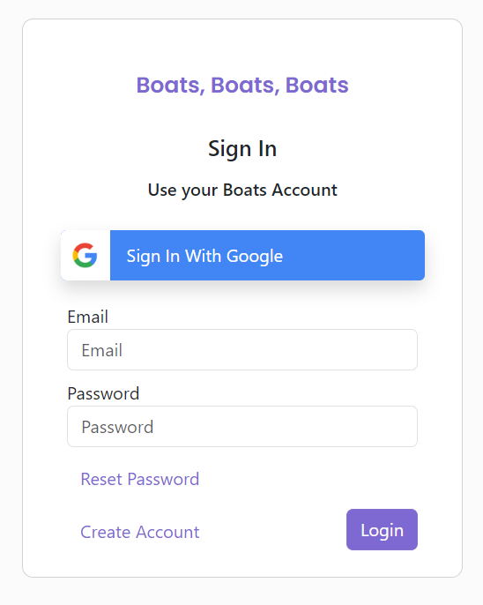
User Registration
User can register with email via /register end point, this ensures a valid email & password are entered
/product is used to query the DB to ensure unique email
If valid email & password → New User entered into DB
Using bcrypt library to hash & salt the password

Slide 7
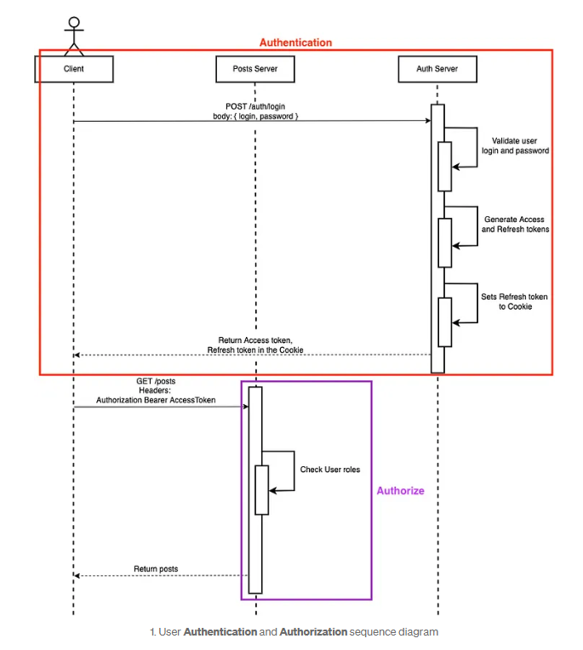
Json Web Token for User Authentication & Authorisation
Registered user is Authenticated via /auth → Assigned Access & Refresh tokens
Access Token → Allows short term access to API’s
Refresh Token → Allows for long term refreshing of Access token
verifyJWT middleware used to determine if user is Authenticated to access the specified endpoint → Do they have valid accessToken
verifyRoles middleware use to determine if user is Authoriszed to access the specified end point → Do they have the required role permissions

Slide 8
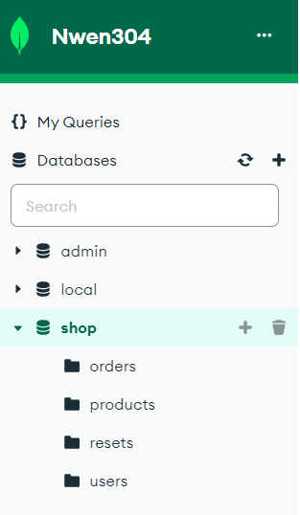
NoSQL Database
-Uses MongoDB compass
-Data stored in collections

Slide 9
Endpoints for resources
-Endpoints are created in routes folder
-Routes direct to methods in controller to apply logic
-Resources are returned using this route

Slide 10
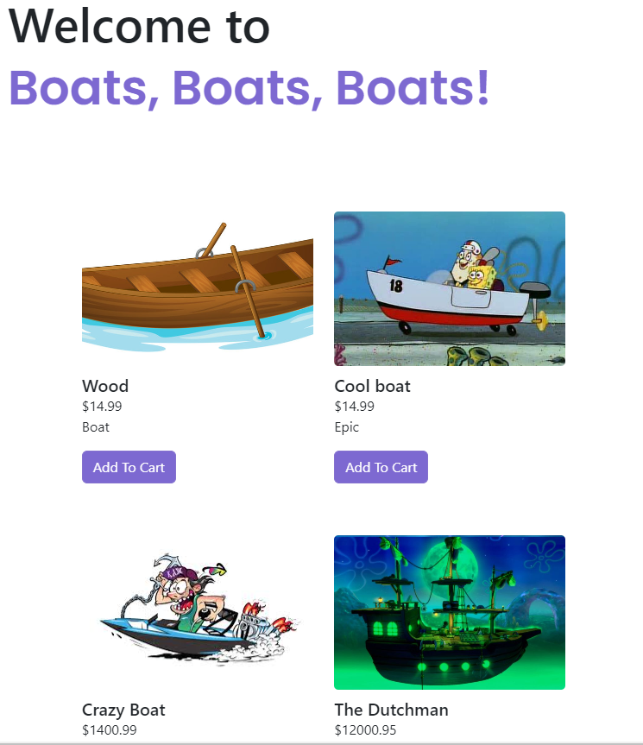
Web Rendering
Rendering of pages is done server-side using Handlebars.js.
It injects passed variables into the template such as product information, user logged in status, edit buttons for admins and cart items.
Dynamic content is rendered through client-side javascript such as loading indicators, editing products, displaying error messages, recommendation fetching.

Slide 11
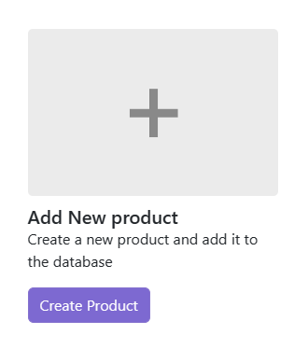
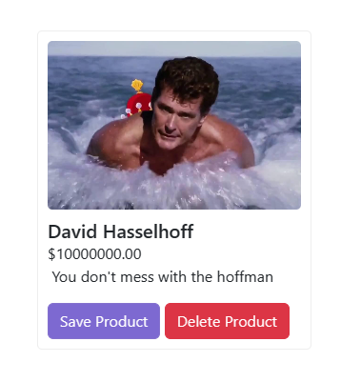

Product Management
Products are able to be easily inserted by any admin account through the products list.
Uses HTML attribute contenteditable to allow the content of the same design as the design that will be displayed to be edited.
This code is reused exactly to allow for editing products as well, with simply the addition of a delete product button.

Slide 12
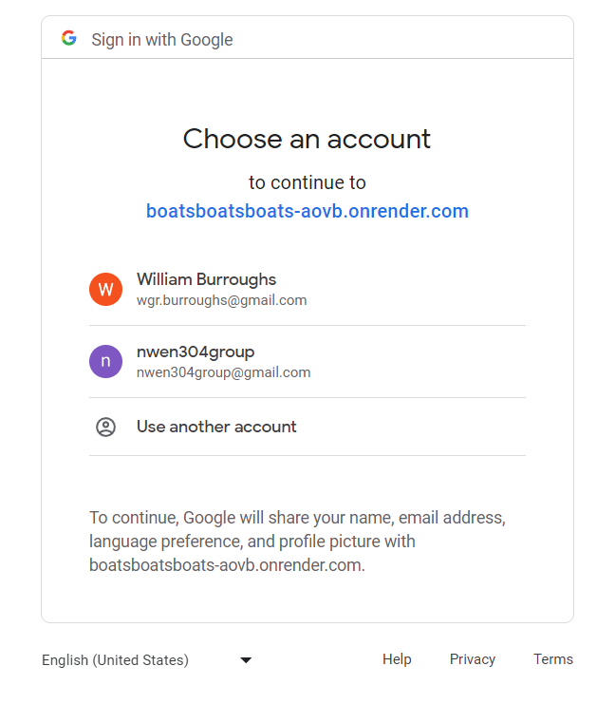
OAuth
User can sign in using Google account
Relies on GoogleAPI & Passport
Handles users that are already registered
Implemented as Microservice so redirects user to other service and redirects back once completed
Hosted separately

Slide 13
Server Hosting
-Server is hosted on cloud using Render (Free)
-3 Services hosted on Render. Main Web Server, OAuth Microservice, Recommendation Microservice
-All initially runs npm install then npm start
-Link for main server is https://boatsboatsboats-aovb.onrender.com
-Linked with GIT so updates can be reflected on server

Slide 14
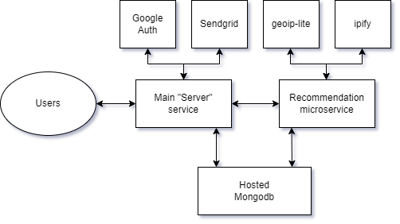
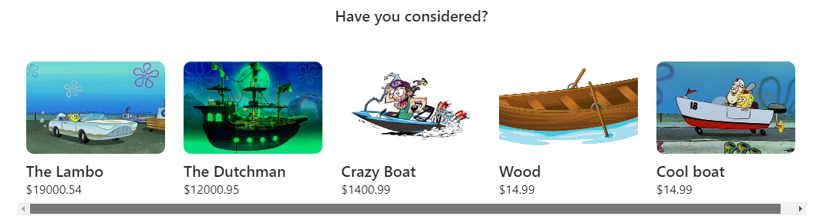
Recommendation Microservice
Listens as its own express server, connecting to the database directly.
Takes a users ip address and finds out what country it is from, then finds out the local gdp per capita of the country to sort recommendations from high to low, or low to high

Slide 15
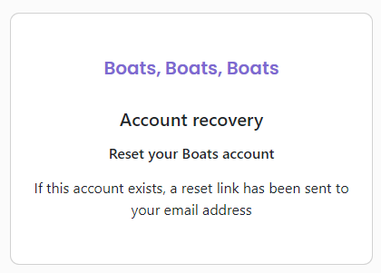
Password Reset - Frontend
Privacy considerations were featured in the Password Reset process.
We were careful to not include any error messages that infer that an email is or isn’t registered on the website.
Sends an email via Sendgrid that contains a password reset link with a reset code parameter.
Front-end allows a new password to be entered and sends it to the back-end.

Slide 16
Password Reset - Backend
-Single use token created for a reset link and stored in resets DB for limited time
-Send via email
-Once link clicked user can reset password once

Slide 17
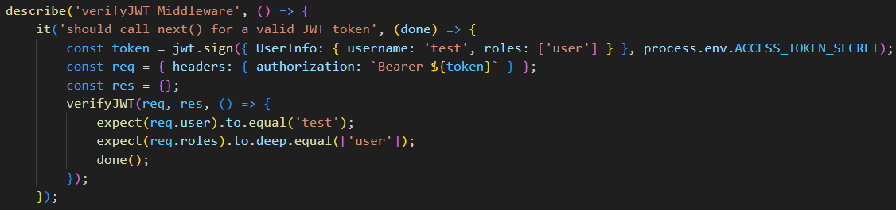
Middleware Testing
Mocha Framework & Chai Assertion Library
verifyJWT → Authentication
verifyRoles → Authorisation

Slide 18
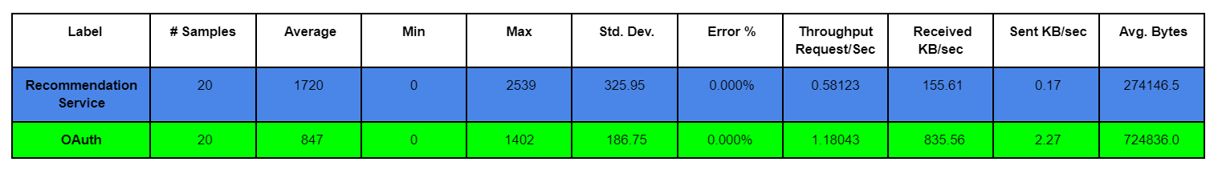
Microservice Response Time
Apache Jmeter
Single user making multiple requests

Slide 19
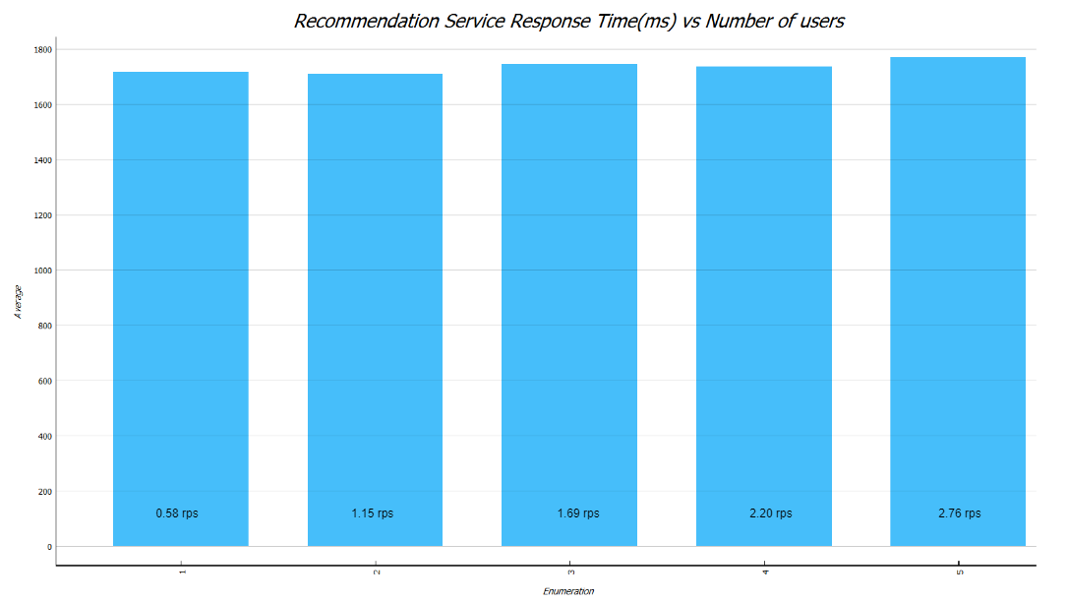
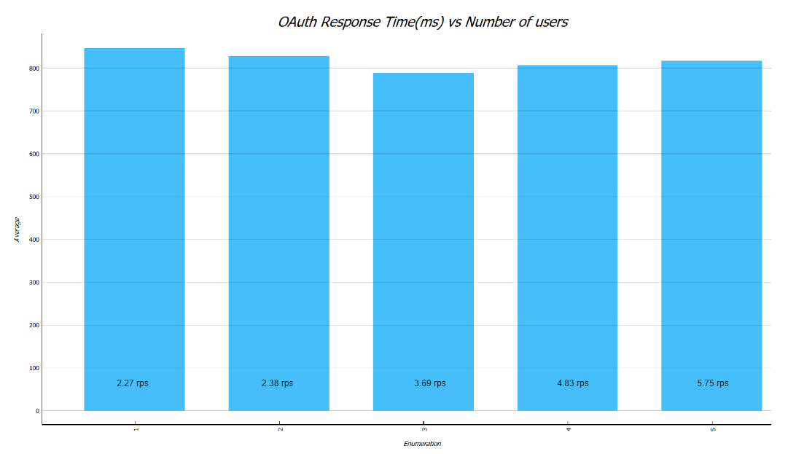
Microservice Load Testing
Apache JMeter
Render server failed before either service ( > 7 simultaneous requests)

Slide 20
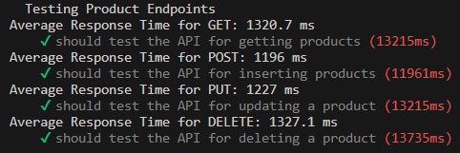
Database Performance
Mocha Framework & Chai Assertion Library
Database performance > Microservice performance → Therefore not the rate limiting component in web app

Slide 21
Demo Time!

